Slide 1
CS 106A, Lecture 24 GCanvas and BiasBars
suggested reading:
Java Ch. 10.5-10.6

Slide 2
Plan for today
Review: Interactors and GCanvas
Practice: Aquarium
BiasBars

Slide 3
Learning Goals
Feel comfortable writing graphical and/or animated programs with multiple classes

Slide 4
Plan for today
Review: Interactors and GCanvas
Practice: Aquarium
BiasBars

Slide 5
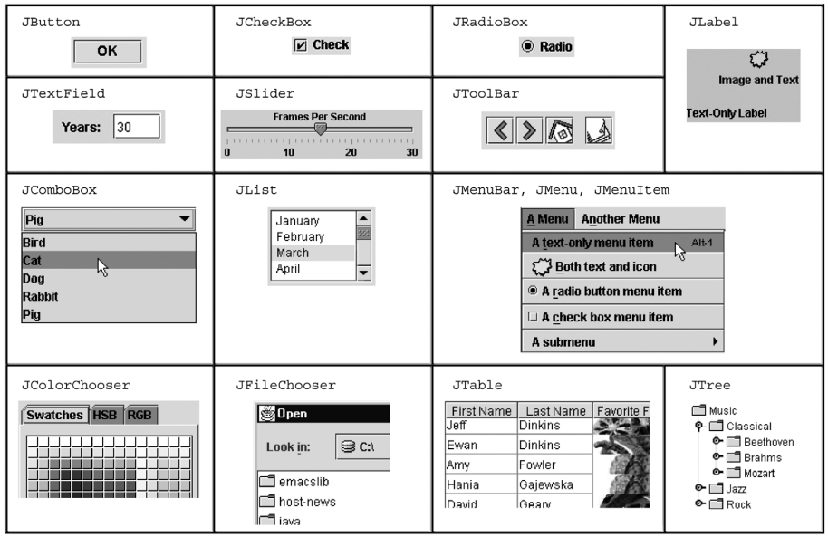
Interactors
Notes:
Going to focus on 3

Slide 6
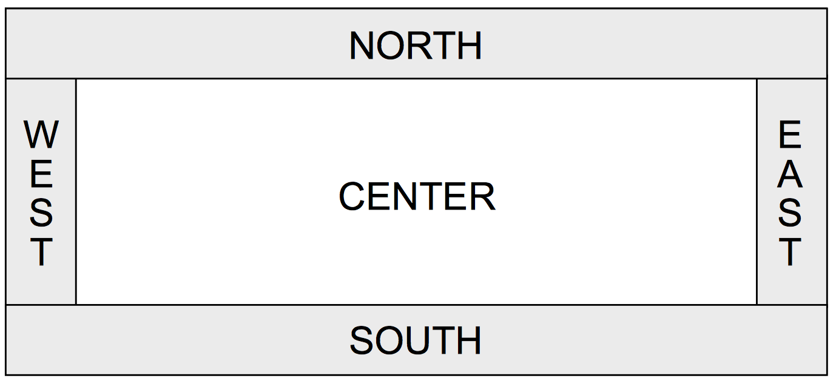
Window Regions
In graphics or console programs, the window is divided into five regions:
The CENTER region is typically where the action happens.
ConsoleProgram adds a console there
GraphicsProgram puts a GCanvas there
Other regions are visible only if you add an interactor to them using add(component, REGION);
Interactors are automatically centered within each region.

Slide 7
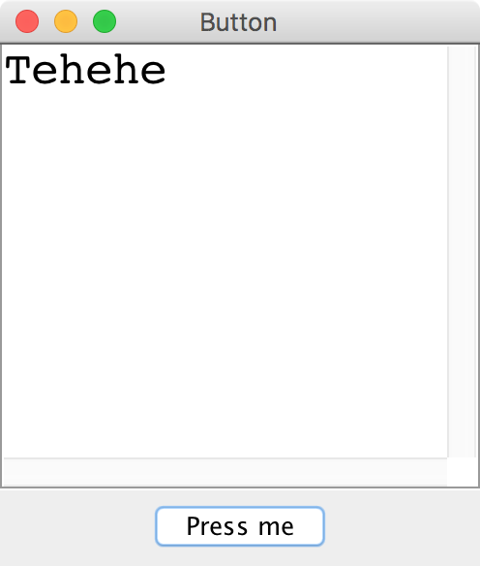
JButton

Slide 8
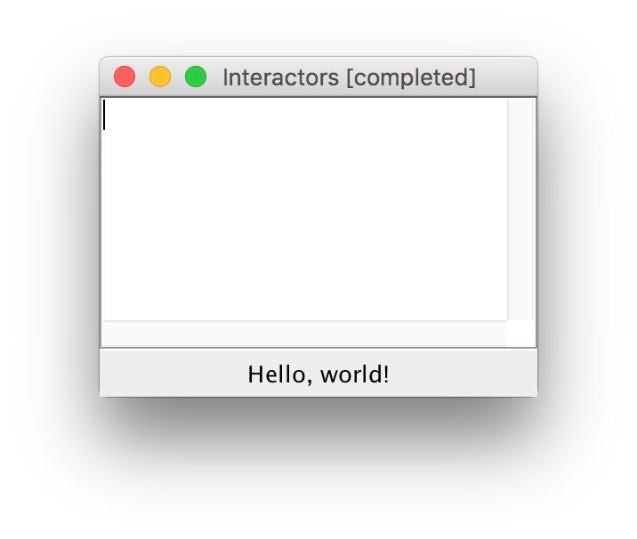
JLabel
JLabel label = new JLabel("Hello, world!");
add(label, SOUTH);

Slide 9
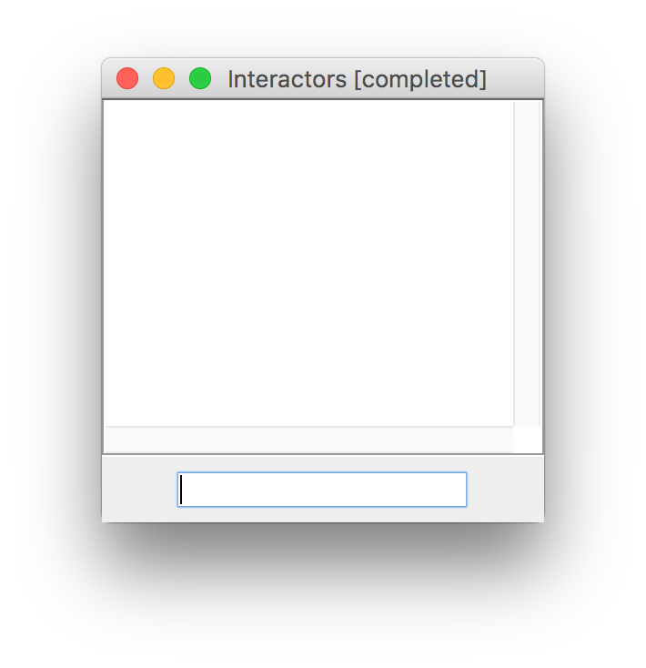
JTextField
JTextField field = new JTextField(10);
add(field, SOUTH);

Slide 10
Responding To User Inputs
To respond to events from interactors, we must do the following:
Call addActionListeners() at the end of init, once we are done adding buttons. This tells Java to let us know if any of the previous buttons were clicked.
Implement the public actionPerformed method. This method is called whenever a button is clicked.
Call addActionListener(this) and optionally setActionCommand(“some command”) on JTextFields that should respond when ENTER is pressed.

Slide 11
ActionEvent
The ActionEvent parameter contains useful event information.
Use getSource or getActionCommand to figure out what button or component was interacted with.
public void actionPerformed(ActionEvent event) {
String command = event.getActionCommand();
if (command.equals("Save File")) {
// user clicked the Save File button
...
}
}
Method | Description
e.getActionCommand() | a text description of the event (e.g., the text of the button clicked)
e.getSource() | the interactor that generated the event

Slide 12
Extending GCanvas
public class Graphics extends Program {
public void run() { // We have to make our own GCanvas now
MyCanvas canvas = new MyCanvas();
add(canvas);
// Can’t do this anymore, because we are
// not using GraphicsProgram’s canvas
// GObject obj = getElementAt(…);
// Do stuff with obj
}
}
Notes:
We CAN say canvas.getElementAt, but we want to decompose all our graphics code out into the MyCanvas file

Slide 13
Extending GCanvas
public class Graphics extends Program {
public void run() { // We have to make our own GCanvas now
MyCanvas canvas = new MyCanvas();
add(canvas);
// Operate on this canvas
GObject obj = canvas.getElementAt(…);
// Do stuff with obj
}
}
Notes:
We CAN say canvas.getElementAt, but we want to decompose all our graphics code out into the MyCanvas file

Slide 14
Extending GCanvas
public class Graphics extends Program {
public void run() { // We have to make our own GCanvas now
MyCanvas canvas = new MyCanvas();
add(canvas);
// Operate on this canvas
canvas.doStuffWithObj(…);
// Best: let canvas handle graphics!
}
}

Slide 15
The init method
init is a special public method, like run, that is called when your program is being initialized.
Unlike run, however, it is called before your program launches, letting you do any initialization you need.
public class MyProgram extends GraphicsProgram { public void init() {
// executed before program launches
}
public void run() {
// executed after program launches
}
}

Slide 16
Plan for today
Review: Interactors and GCanvas
Practice: Aquarium
BiasBars

Slide 17
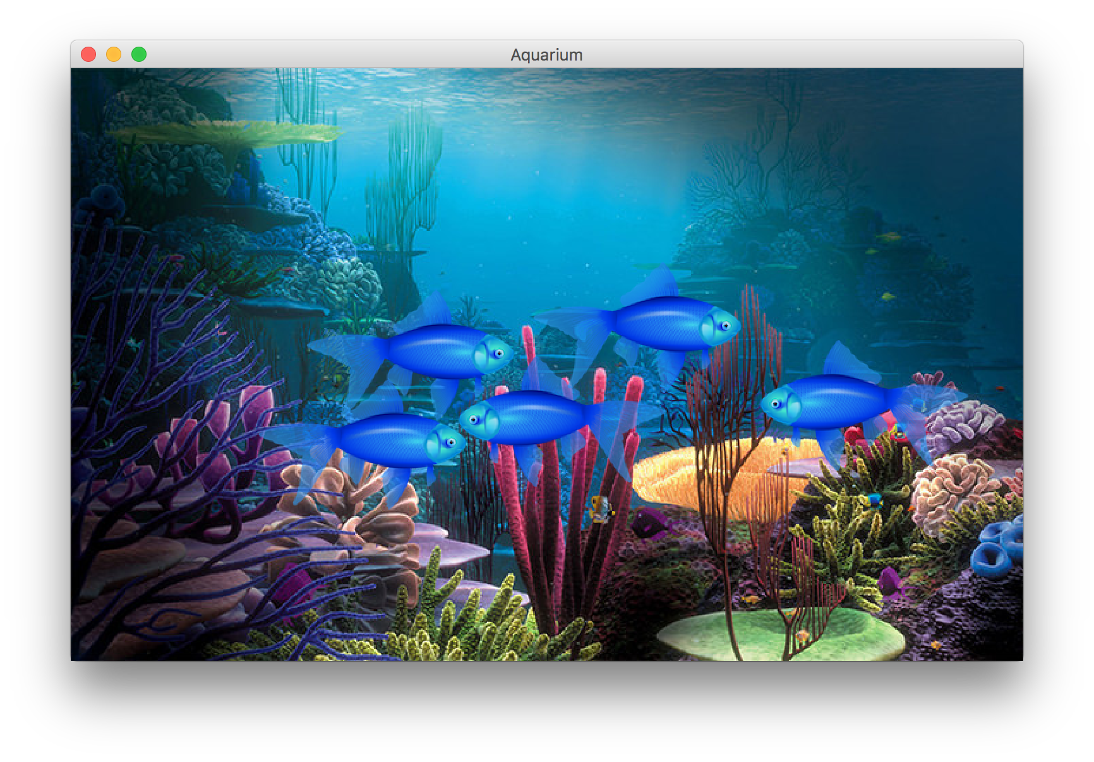
Practice: Aquarium
Let’s write a graphical program called Aquarium that simulates fish swimming around.
To decompose our code, we can make our own GCanvas subclass.

Slide 18
Plan for today
Review: Interactors and GCanvas
Practice: Aquarium
BiasBars

Slide 19
BiasBars

Slide 20
BiasBars Structure
BiasBars.java – handles the interactors and overall program
BiasBarsEntry – handles information about a single descriptor and its frequencies for each gender
BiasBarsDatabase – keeps track of all entries and looks up info by descriptor
BiasBarsGraph – a GCanvas subclass that displays bar graphs for descriptors specified by the user

Slide 21
BiasBars Structure
BiasBarsGraph
Graphs the currently selected BiasBarsEntry, if any
Hands over the BiasBarsEntry that needs to be graphed
BiasBars
Main program
Receives user input, reads from the database, and tells the graph what to display
Asks for BiasBarsEntrys
BiasBarsDataBase
Creates and manages BiasBarsEntrys
Returns BiasBarsEntrys
BiasBarsEntry
gender-data.txt
BiasBarsEntry
fair W 1018 1240 … M 3155 380 …
inevitable W 59 29 … M 170 14 …
different W 1318 1660 … M 3789 1012 …
...
BiasBarsEntry

Slide 22
BiasBars Structure
BiasBars.java – handles the interactors and overall program
BiasBarsEntry – handles information about a single descriptor and its frequencies for each gender
BiasBarsDatabase – keeps track of all entries and looks up info by descriptor
BiasBarsGraph – a GCanvas subclass that displays bar graphs for descriptors specified by the user
Notes:
Like Aquarium.java

Slide 23
BiasBars Structure
BiasBars.java – handles the interactors and overall program
BiasBarsEntry – handles information about a single descriptor and its frequencies for each gender
BiasBarsDatabase – keeps track of all entries and looks up info by descriptor
BiasBarsGraph – a GCanvas subclass that displays bar graphs for descriptors specified by the user

Slide 24
BiasBarsEntry
Responsible for storing the data about one name/line in the text file -> name and ranks. (Hint: use a Scanner!)
What instance variables does a BiasBarsEntry need?
Implement the following methods:
public BiasBarsEntry(String dataLine)
public String getDescriptor()
public ArrayList<Integer>
getFrequencies(char gender)
public int getMaxFrequency()
public String toString()
nice W 2031 10179 1077 3338 2311 M 4606 2926 3274 9603 2682

Slide 25
BiasBars Structure
BiasBars.java – handles the interactors and overall program
BiasBarsEntry – handles information about a single descriptor and its frequencies for each gender
BiasBarsDatabase – keeps track of all entries and looks up info by descriptor
BiasBarsGraph – a GCanvas subclass that displays bar graphs for descriptors specified by the user

Slide 26
BiasBarsDatabase
Responsible for reading in the text file and creating/storing BiasBarsEntry objects.
Needs to be able to find entries given their descriptor (case insensitive!). What data structure might be useful here?

Slide 27
BiasBarsDatabase
import java.io.*;
import java.util.*;
public class BiasBarsDatabase implements BiasBarsConstants {
public BiasBarsDatabase(String filename) {
// TODO: fill this in
}
public BiasBarsEntry findEntry(String descriptor) {
// TODO: implement this method
return null;
}
}

Slide 28
BiasBars Structure
BiasBars.java – handles the interactors and overall program
BiasBarsEntry – handles information about a single descriptor and its frequencies for each gender
BiasBarsDatabase – keeps track of all entries and looks up info by descriptor
BiasBarsGraph – a GCanvas subclass that displays bar graphs for descriptors specified by the user

Slide 29
BiasBarsGraph
A subclass of GCanvas that handles all the graph drawing (similar to FishTank.java in our Aquarium program)
Two bars for each comment source: one for women (left) and one for men (right)
Setting up axes requires lots of math, but don’t stress about details until basic functionality is done
Tip: use the output comparison tool for the finishing touches!

Slide 30
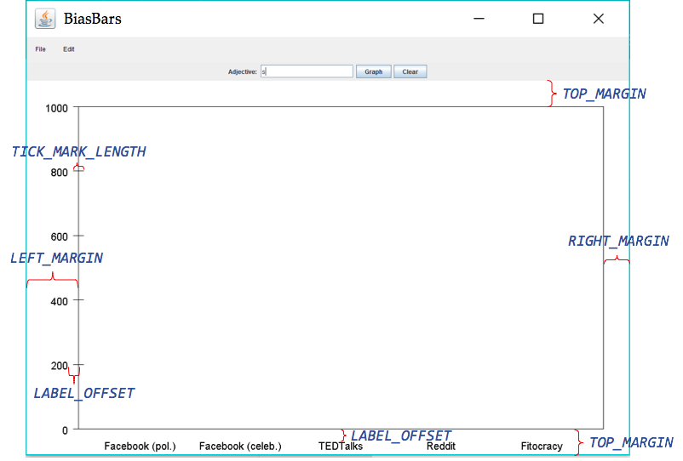
BiasBarsGraph
Diagram not to scale! And you will have more tick marks

Slide 31
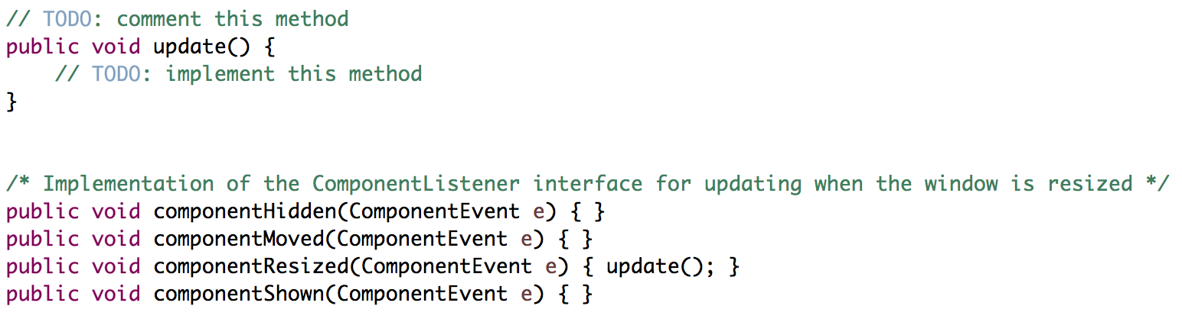
BiasBarsGraph: Resizing

Slide 32
BiasBarsGraph: Resizing
Every time the window resizes, update() is called.
Therefore, update() must clear and redraw the whole graph.
This means the graph must keep track of the entry currently graphed so it can redraw the bars whenever it needs to.
Other required methods:
clear()
addEntry(BiasBarsEntry entry)
These methods do NOT actually alter the graphics. You must call update() to do that, since update() must do all the drawing.

Slide 33
Recap
Review: Interactors and GCanvas
Practice: Aquarium
BiasBars
Next time: Life After CS106A, Part 1

